Slide 1
3D Computer Vision
Dr. Hassan Foroosh
School of EECS
UCF

Slide 2
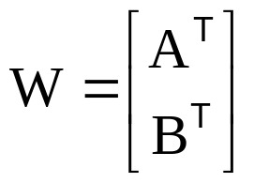

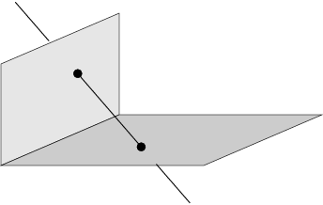
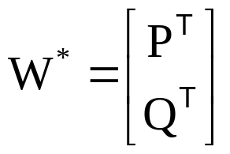


Last Lecture
Lines

Slide 3
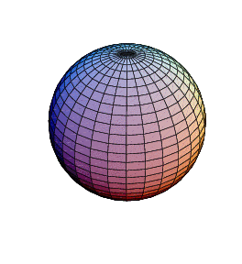
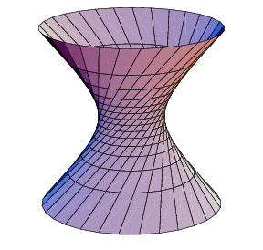
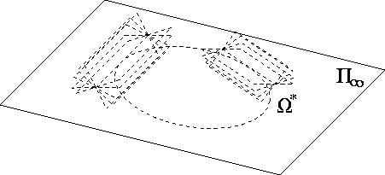
Today
Quadrics
П∞, ω∞ and Ω ∞

Slide 4

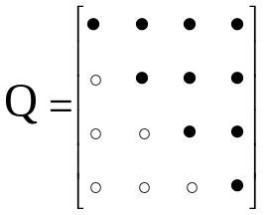







Quadrics and dual quadrics
(Q : 4x4 symmetric matrix)
9 d.o.f.
in general 9 points define quadric
det Q=0 ↔ degenerate quadric
pole – polar
(plane ∩ quadric)=conic
transformation
relation to quadric (non-degenerate)
transformation
Notes:
3. and thus defined by less points
4. On quadric=> tangent, outside quadric=> plane through tangent point
5. Derive X’QX=x’M’QMx=0

Slide 5
Quadric classification
Rank | Sign. | Diagonal | Equation | Realization
4 | 4 | (1,1,1,1) | X²+ Y²+ Z²+1=0 | No real points
 | 2 | (1,1,1,-1) | X²+ Y²+ Z²=1 | Sphere
 | 0 | (1,1,-1,-1) | X²+ Y²= Z²+1 | Hyperboloid (1S)
3 | 3 | (1,1,1,0) | X²+ Y²+ Z²=0 | Single point
 | 1 | (1,1,-1,0) | X²+ Y²= Z² | Cone
2 | 2 | (1,1,0,0) | X²+ Y²= 0 | Single line
 | 0 | (1,-1,0,0) | X²= Y² | Two planes
1 | 1 | (1,0,0,0) | X²=0 | Single plane
Notes:
Signature sigma= sum of diagonal,e.g. +1+1+1-1=2,always more + than -, so always positive…

Slide 6
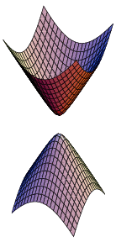
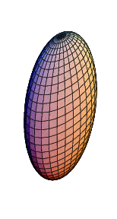
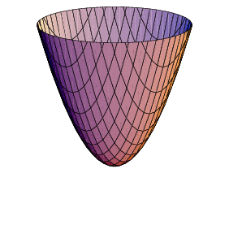
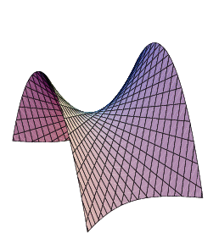
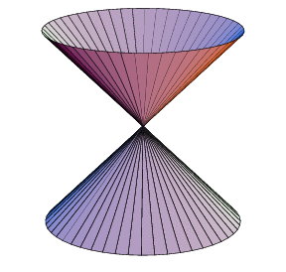
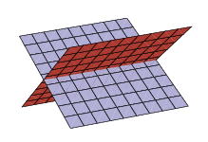
Quadric classification
Projectively equivalent to sphere:
sphere
ellipsoid
hyperboloid of two sheets
paraboloid
Ruled quadrics:
hyperboloids of one sheet
Degenerate ruled quadrics:
cone
two planes
Notes:
Ruled quadric: two family of lines, called generators.
Hyperboloid of 1 sheet topologically equivalent to torus!

Slide 7
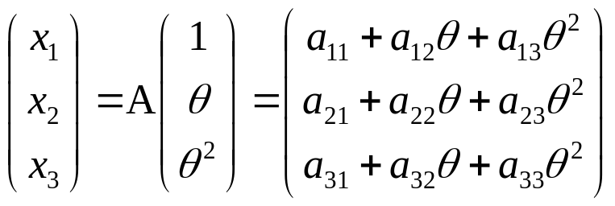
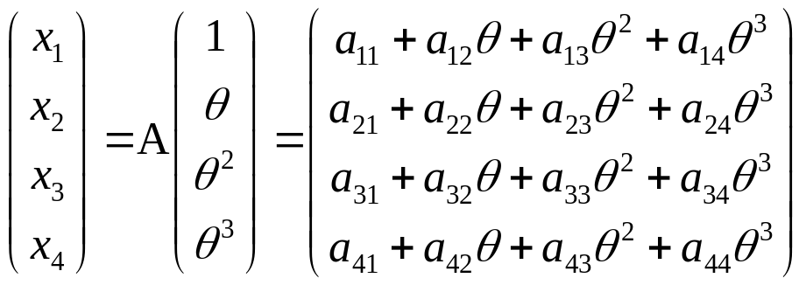
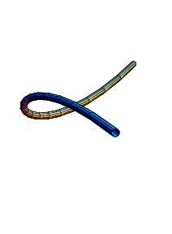
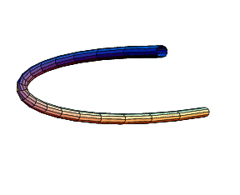
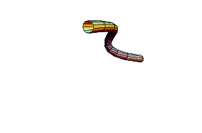
Twisted cubic
twisted cubic
conic
3 intersection with plane (in general)
12 dof (15 for A – 3 for reparametrisation (1 θ θ²θ³)
2 constraints per point on cubic, defined by 6 points
projectively equivalent to (1 θ θ²θ³)
Horopter & degenerate case for reconstruction

Slide 8
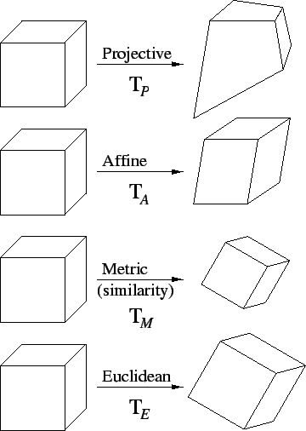
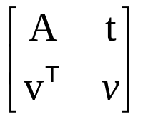
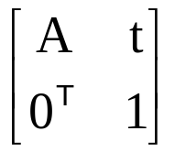
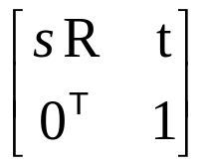
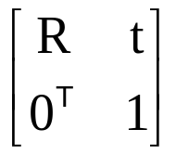
Hierarchy of transformations
Projective
15dof
Intersection and tangency
Parallellism of planes,
Volume ratios, centroids,
The plane at infinity π∞
Affine
12dof
Similarity
7dof
The absolute conic Ω∞
Euclidean
6dof
Volume

Slide 9
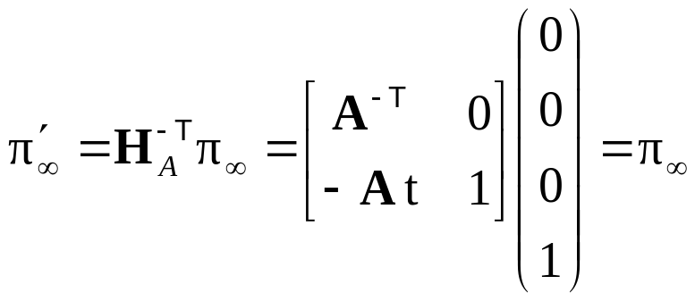


The plane at infinity
The plane at infinity π∞ is a fixed plane under a projective transformation H iff H is an affinity
canical position
contains directions
two planes are parallel ⇔ line of intersection in π∞
line // line (or plane) ⇔ point of intersection in π∞
Notes:
Represents 3DOF between projective and affine

Slide 10
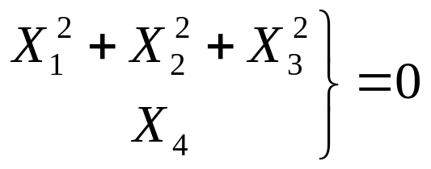
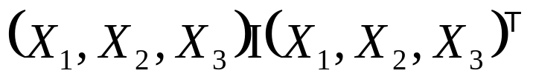
The absolute conic
The absolute conic Ω∞ is a (point) conic on π∞.
In a metric frame:
or conic for directions:
(with no real points)
The absolute conic Ω∞ is a fixed conic under the projective transformation H iff H is a similarity
Ω∞ is only fixed as a set
Circle intersect Ω∞ in two points
Spheres intersect π∞ in Ω∞
Notes:
Represent 5 DOF between affine and similarity

Slide 11
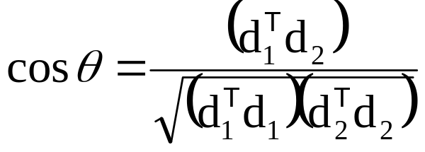
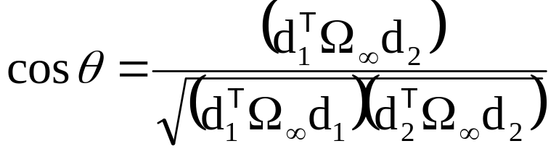
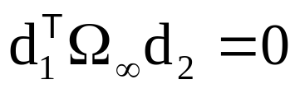
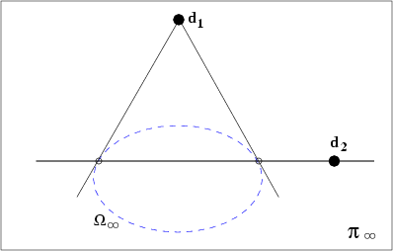
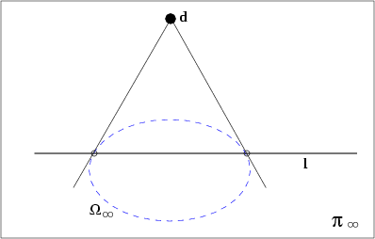
The absolute conic
Euclidean:
Projective:
(orthogonality=conjugacy)
normal
plane
Notes:
Orthogonality is conjugacy with respect to Absolute Conic

Slide 12
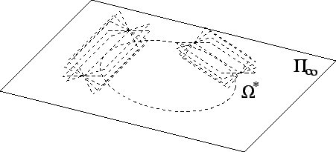
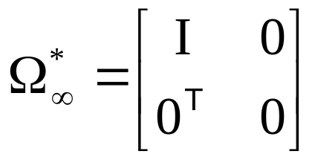
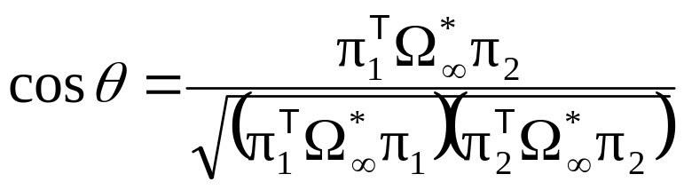
The absolute dual quadric
The absolute conic Ω*∞ is a fixed conic under the projective transformation H iff H is a similarity
8 dof
plane at infinity π∞ is the nullvector of Ω∞
Angles:

Slide 13
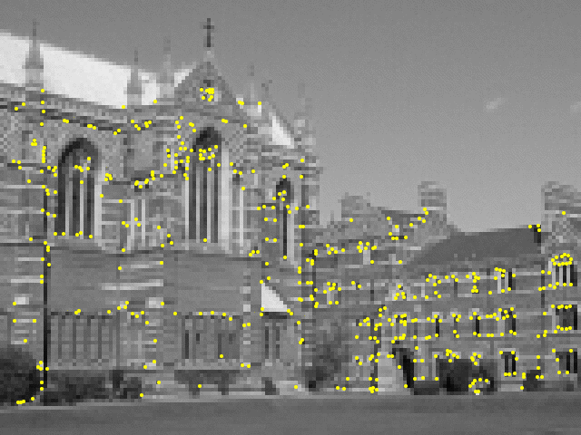
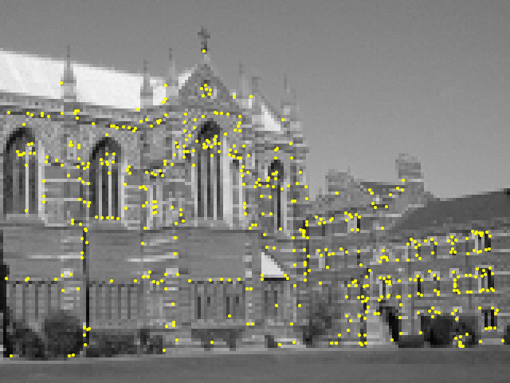
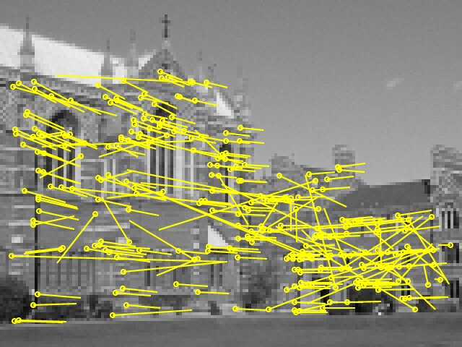
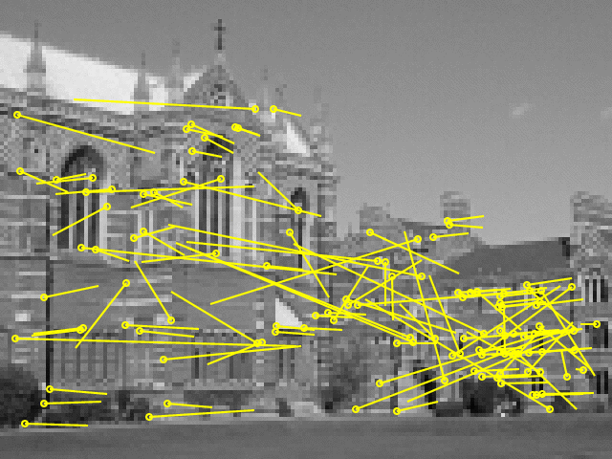
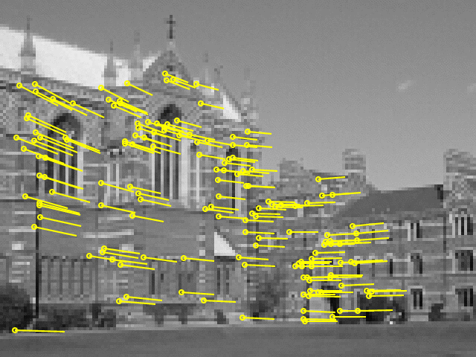
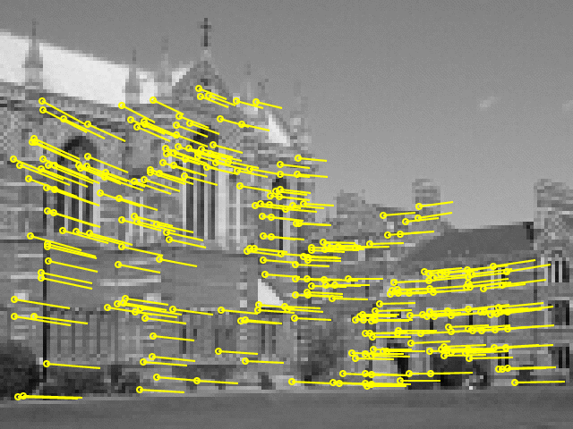
Next classes:Parameter estimation
Direct Linear Transform
Iterative Estimation
Maximum Likelihood Est.
Robust Estimation

